Slide 1
Assessing the Resilience of Word-Level Differential Privacy Mechanisms: An Adversarial Approach
17/6/2024, Master’s Thesis Final Presentation
Furkan Yilmaz

Slide 2
Outline
Motivation
Research Questions
Methodology
Results & Main Findings
Limitations & Future Work

Slide 3





Motivation
Introduction:
Current Natural Language Processing (NLP) techniques are firmly ingrained in Big Data
Privacy Concerns:
However, using these methods may require handling private or sensitive data
As a result, privacy in NLP has come under more attention
Privacy Example:
Health Information: Medical records, Prescription details…
Financial Information: Bank account numbers, Social Security numbers
Differential Privacy (DP):
A prominent and extensively studied strategy is Differential Privacy (DP), drawing the focus of many researchers on how to integrate this privacy enhancement tool into NLP models
Notes:
Introduction:
Current NLP techniques are pivotal in managing text-based tasks within the realm of Big Data.
Privacy Concerns:
The integration of NLP methods often involves dealing with private or sensitive data.
The increased attention to privacy in NLP has become imperative.
Differential Privacy (DP):
DP emerges as a prominent and extensively studied strategy.
Many researchers focus on incorporating DP into NLP models to enhance privacy.

Slide 4


Motivation
Word-Level DP Mechanism Illustration
Random Noise
The key to the office is hidden under the mat.
DP Mechanism
The change can
another office only invisible as another mat.

Slide 5




Motivation
Research Gap:
Thesis Objective:
Assessment of word-level DP mechanisms against adversary NLP models.
Formerly people were assessing the privacy level via theoretical guarantees using epsilon values
Investigation of the adversarial attacks on privacy with the aim of revealing the original text inputs from the privatized, obfuscated text outputs
The key to the office is hidden under the mat.
The change can
another office only invisible as another mat.
Notes:
Research Gap:
Despite advancements, assessing word-level DP mechanisms against adversarial NLP models remains an open research area.
Be more specific
Mentıon the before, Task specific mazbe and not like lıterallz mımıckıng
Thesis Objective:
The thesis aims to investigate unveil privacy, specifically targeting the revelation of original text inputs from privatized, obfuscated text outputs generated by word-level DP mechanisms.

Slide 6
Outline
Motivation
Research Questions
Methodology
Results & Main Findings
Limitations & Future Work

Slide 7
Research Questions
What prerequisites must be satisfied in order for an attacker to infer original plaintext from privatized, obfuscated text outputs?
What specific training methodologies and architectural features are essential for a model to possess the capability to be able to retrieve the original plaintext?
  What are the suitable metrics to assess how well these models work in terms of recovering the original plaintext?
How can a benchmark be devised to evaluate and compare the resilience of alternative models trained with word-level differential privacy for privatizing textual inputs against an attacker's attempts to infer the original inputs?

Slide 8
Outline
Motivation
Research Questions
Methodology
Results & Main Findings
Limitations & Future Work

Slide 9
Introduction MV & TG
We have used
2 DP mechanisms
Truncated Gumbel Mechanism:
Gumbel Distribution: Noise sampled here.
Truncation: Limits noise range to maintain utility.
Multivariate Calibrate Mechanism:
Add correlated noise using multivariate Laplace distribution.
Sentence 1
DP Mechanism
Sentence 2
Random Noise

Slide 10
Methodology – An Overview
Train Phase:
Train an adversary model
Evaluation Phase:
Evaluate the adversary model
on obfuscated sets

Slide 11




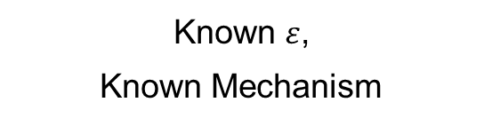





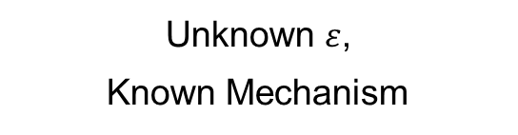

Methodology – Attacker Personas
Attacker 1
Attacker 2
Attacker 3
$$ε=1$$
$$ε=2$$
$ε=$?
$$ε=0.5$$
$ε=$?
$ε=$?
Known $ε$,
Known Mechanism
Unknown $ε$,
Known Mechanism
Unknown $ε$,
Unknown Mechanism
The amount of known information will affect how a training dataset is created !

Slide 12








Methodology – Model Train Phase: Dataset Creation
$ε=$9
The Truncated-Gumbel and Multivariate-Calibrate word-level Differential Privacy (DP) mechanisms were selected, and six datasets were generated using these mechanisms.
MV
Input
$ε=$12
$ε=$15
Wikipedia
Dataset consists of original text and the obfuscated text.
Obfuscated
Wikipedia Sets
$ε=$1
TG
Input
$ε=$50
Dataset (csv):
Original S.
Obfuscated S.
Original S.
Obfuscated S.
Original S.
Obfuscated S.
$ε=$100
Original S.
Obfuscated S.

Slide 13


Methodology – Model Train Phase: Adversary Model Training
Do:
For Each:
MV Sets
TG Sets
Wikipedia
Model
Obfuscated
Wikipedia Set
Loss()
Predict
Feed
Prediction
Merged MV
Merged TG
Update
weights
Merged MV&TG
Text generation
model
9 Different adversary NLP models are trained

Slide 14



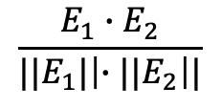



Evaluation Phase – Metrics
ROUGE-1 Score
=
$$\frac{Number of words shared between the machine generated deobfuscated sentence and the original sentence}{The total number of words in the original sentence}$$
Sentence transformer
Cosine Similarity Score
$$Sentence_{1}$$
$$Embedding_{1}$$
=>
=
$$\frac{E_{1}∙E_{2}}{{||E}_{1}|\left|∙{||E}_{2}\right||}$$
$$Sentence_{2}$$
$$Embedding_{2}$$

Slide 15
Evaluation Phase – The Benchmark
General Test
Why ?
To see how resilient is DP mechanism in general against a deobfuscation attack
Epsilon Test
Why ?
To see how resilience of DP mechanism changes per 𝜺
Deobfuscation Test
Why ?
To see if text generation models are more prone to errors after an initial incorrectly predicted word earlier in the sentence.

Slide 16
Methodology – Evaluation Phase: General Test
$ε=$9
Test for each Adversarial Model:
MV
Merged MV
Input
$ε=$12
Models trained on 1 𝜺 value & 1 DP mechanism
Wikipedia
&
Yelp
Models trained on several 𝜺 values but 1 DP mechanism
$ε=$15
Models trained on several 𝜺 values and both DP mechanism
$ε=$1
TG
Merged TG
Input
$ε=$50
OUTPUT
ROUGE Scores
Cosine Similarity Scores
Cross Entropy Loss
$ε=$100

Slide 17


Methodology – Evaluation Phase: Epsilon Test
Test for each Adversarial Model:
MV
$ε=$ [5 – 20]
Input
…
Models trained on 1 𝜺 value & 1 DP mechanism
Wikipedia
&
Yelp
Models trained on several 𝜺 values but 1 DP mechanism
Models trained on several 𝜺 values and both DP mechanism
TG
$ε=$[1 – 1000]
Input
OUTPUT
ROUGE Scores
Cosine Similarity Scores
…

Slide 18


Methodology – Evaluation Phase: Deobfuscation Test
Test for each Adversarial Model:
MV
Input
$ε=$ [5 – 20]
Models trained on 1 𝜺 value & 1 DP mechanism
Wikipedia
&
Yelp
Models trained on several 𝜺 values but 1 DP mechanism
Wikipedia datasets have 1 word obfuscated
Yelp datasets have 2 words obfuscated
Models trained on several 𝜺 values and both DP mechanism
TG
Input
$ε=$[1 – 1000]
OUTPUT
ROUGE Scores
Cosine Similarity Scores

Slide 19
Outline
Motivation
Research Questions
Methodology
Results & Main Findings
Limitations & Future Work

Slide 20
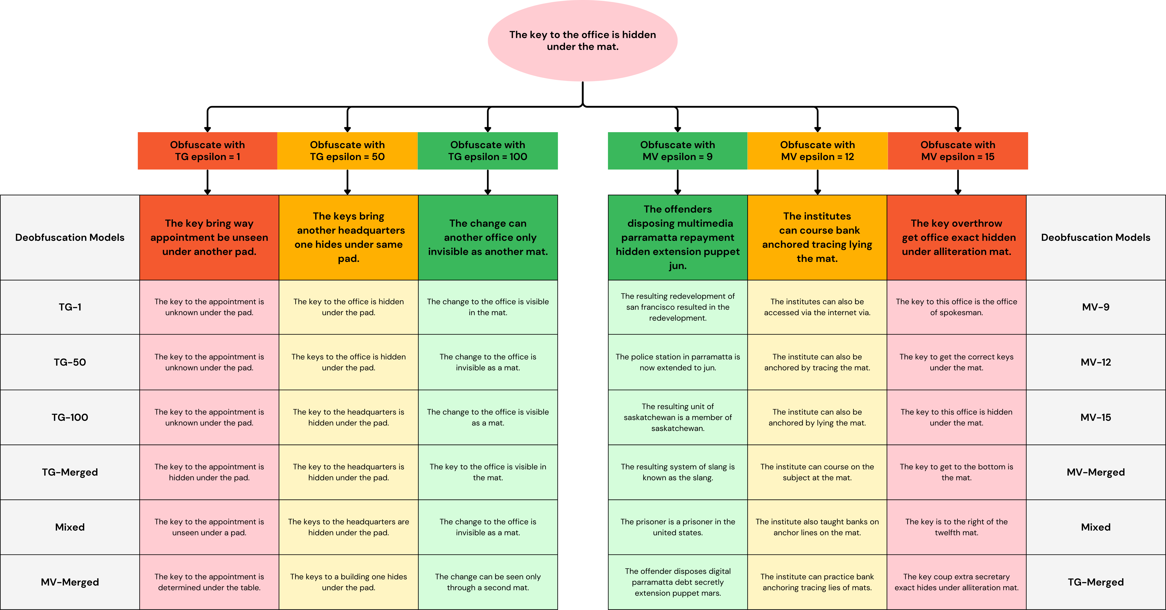
Deobfuscation Example

Slide 21
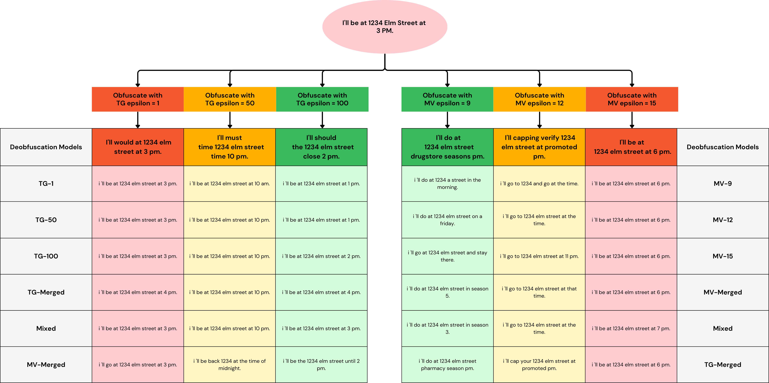
Deobfuscation Example

Slide 22

Main Findings
1
4
Familiarity with the DP Mechanism is Advantages for Attackers
3
Epsilon Knowledge is Negligible for Adversaries
The Importance Lies in Obfuscation Percentage, Not Location
2
The Significance of Training Dataset Similarity to the Test Set
5
Absence of Error Accumulation in Text Generation Models

Slide 23
Main Finding 1: Knowing DP Mechanism is Important
English Wikipedia
Yelp
Truncated-Gumbel Test Set Results
Model Trained on | Rouge 1 | Cosine Similarity
TG 𝜺=1 | 0.703 / 0.398 | 0.825 / 0.742
TG 𝜺=50 | 0.705 / 0.398 | 0.827 / 0.742
TG 𝜺=100 | 0.703 / 0.398 | 0.827 / 0.742
TG all 𝜺’s | 0.724 / 0.398 | 0.840 / 0.742
TG all 𝜺’s MV all 𝜺’s | 0.714 / 0.398 | 0.829 / 0.742
MV all 𝜺’s | 0.558 / 0.398 | 0.744 / 0.742
TG 𝜺=1 | 0.575 / 0.36 | 0.766 / 0.728
TG 𝜺=50 | 0.584 / 0.36 | 0.775 / 0.728
TG 𝜺=100 | 0.585 / 0.36 | 0.775 / 0.728
TG all 𝜺’s | 0.584 / 0.36 | 0.769 / 0.728
TG all 𝜺’s MV all 𝜺’s | 0.536 / 0.36 | 0.746 / 0.728
MV all 𝜺’s | 0.427 / 0.36 | 0.651 / 0.728
Notice:
The model trained only on MV datasets performs poorly compared to others!
Keynote:
Scores are in the range [0, 1]
& structured as AD / AO
AD: After Deobfuscation
AO: After Obfuscation

Slide 24
Main Finding 1: Knowing DP Mechanism is Important
English Wikipedia
Yelp
Multivariate-Calibrate Test Set Results
Model Trained on | Rouge 1 | Cosine Similarity
MV 𝜺=9 | 0.348 / 0.23 | 0.47 / 0.386
MV 𝜺=12 | 0.364 / 0.23 | 0.487 / 0.386
MV 𝜺=15 | 0.374 / 0.23 | 0.495 / 0.386
MV all 𝜺’s | 0.386 / 0.23 | 0.515 / 0.386
TG all 𝜺’s MV all 𝜺’s | 0.367 / 0.23 | 0.494 / 0.386
TG all 𝜺’s | 0.21 / 0.23 | 0.375 / 0.386
MV 𝜺=9 | 0.249 / 0.295 | 0.321 / 0.458
MV 𝜺=12 | 0.304 / 0.295 | 0.402 / 0.458
MV 𝜺=15 | 0.352 / 0.295 | 0.462 / 0.458
MV all 𝜺’s | 0.336 / 0.295 | 0.432 / 0.458
TG all 𝜺’s MV all 𝜺’s | 0.283 / 0.295 | 0.386 / 0.458
TG all 𝜺’s | 0.242 / 0.295 | 0.427 / 0.458
Notice:
The model trained only on TG datasets performs poorly compared to others!
Keynote:
Scores are in the range [0, 1]
& structured as AD / AO
AD: After Deobfuscation
AO: After Obfuscation

Slide 25
Main Findings
1
4
Familiarity with the DP Mechanism is Advantages for Attackers
3
Epsilon Knowledge is Negligible for Adversaries
The Importance Lies in Obfuscation Percentage, Not Location
2
The Significance of Training Dataset Similarity to the Test Set
5
Absence of Error Accumulation in Text Generation Models

Slide 26
Main Finding 2: The Significance of Training & Test Set Similarity
English Wikipedia
Yelp
Truncated-Gumbel Test Set Results
Model Trained on | Rouge 1 | Cosine Similarity
TG 𝜺=1 | 0.703 / 0.398 | 0.825 / 0.742
TG 𝜺=50 | 0.705 / 0.398 | 0.827 / 0.742
TG 𝜺=100 | 0.703 / 0.398 | 0.827 / 0.742
TG all 𝜺’s | 0.724 / 0.398 | 0.840 / 0.742
TG all 𝜺’s MV all 𝜺’s | 0.714 / 0.398 | 0.829 / 0.742
MV all 𝜺’s | 0.558 / 0.398 | 0.744 / 0.742
TG 𝜺=1 | 0.575 / 0.36 | 0.766 / 0.728
TG 𝜺=50 | 0.584 / 0.36 | 0.775 / 0.728
TG 𝜺=100 | 0.585 / 0.36 | 0.775 / 0.728
TG all 𝜺’s | 0.584 / 0.36 | 0.769 / 0.728
TG all 𝜺’s MV all 𝜺’s | 0.536 / 0.36 | 0.746 / 0.728
MV all 𝜺’s | 0.427 / 0.36 | 0.651 / 0.728
Check the same color arrows in the same column and observe the difference!
Keynote:
Scores are in the range [0, 1]
& structured as AD / AO
AD: After Deobfuscation
AO: After Obfuscation
Reminder:
All models trained only on Wikipedia!

Slide 27
Main Finding 2: The Significance of Training & Test Set Similarity
English Wikipedia
Yelp
Multivariate-Calibrate Test Set Results
Model Trained on | Rouge 1 | Cosine Similarity
MV 𝜺=9 | 0.348 / 0.23 | 0.47 / 0.386
MV 𝜺=12 | 0.364 / 0.23 | 0.487 / 0.386
MV 𝜺=15 | 0.374 / 0.23 | 0.495 / 0.386
MV all 𝜺’s | 0.386 / 0.23 | 0.515 / 0.386
TG all 𝜺’s MV all 𝜺’s | 0.367 / 0.23 | 0.494 / 0.386
TG all 𝜺’s | 0.21 / 0.23 | 0.375 / 0.386
MV 𝜺=9 | 0.249 / 0.295 | 0.321 / 0.458
MV 𝜺=12 | 0.304 / 0.295 | 0.402 / 0.458
MV 𝜺=15 | 0.352 / 0.295 | 0.462 / 0.458
MV all 𝜺’s | 0.336 / 0.295 | 0.432 / 0.458
TG all 𝜺’s MV all 𝜺’s | 0.283 / 0.295 | 0.386 / 0.458
TG all 𝜺’s | 0.242 / 0.295 | 0.427 / 0.458
Check the same color arrows in the same column and observe the difference!
Keynote:
Scores are in the range [0, 1]
& structured as AD / AO
AD: After Deobfuscation
AO: After Obfuscation
Reminder:
All models trained only on Wikipedia!

Slide 28
Main Findings
1
4
Familiarity with the DP Mechanism is Advantages for Attackers
3
Epsilon Knowledge is Negligible for Adversaries
The Importance Lies in Obfuscation Percentage, Not Location
2
The Significance of Training Dataset Similarity to the Test Set
5
Absence of Error Accumulation in Text Generation Models

Slide 29
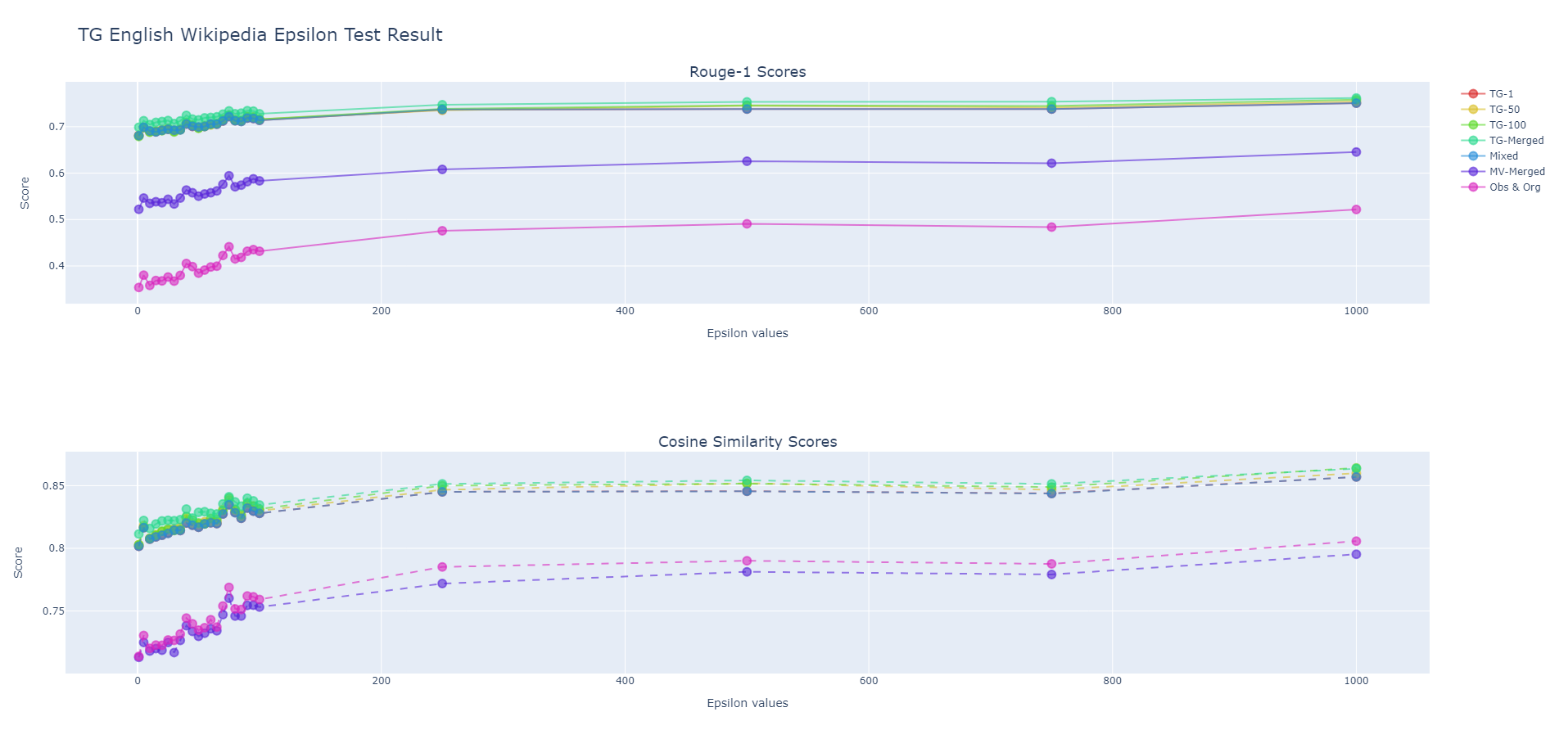
Main Finding 3: Epsilon Knowledge is Negligible for Adversaries
Models trained with
all 𝜺 values & highest 𝜺 value
stays at the top in general
Models trained with
all 𝜺 values & highest 𝜺 value
stays at the top in general

Slide 30
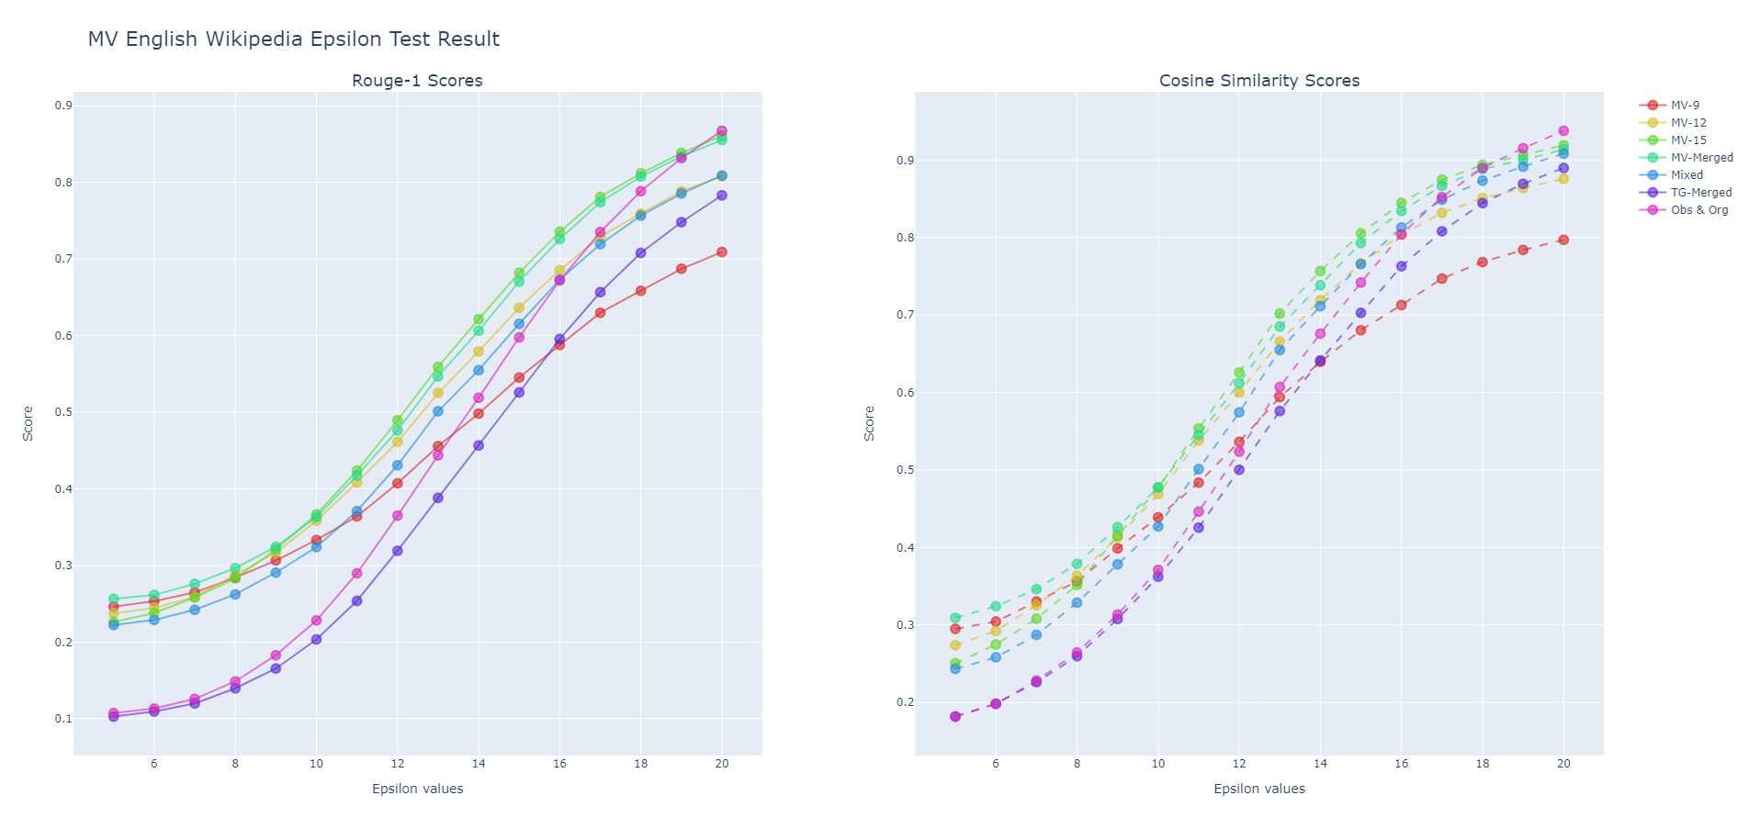
Main Finding 3: Epsilon Knowledge is Negligible for Adversaries
Models trained with
all 𝜺 values & highest 𝜺 value
stays at the top in general
Models trained with
all 𝜺 values & highest 𝜺 value
stays at the top in general

Slide 31
Main Findings
1
4
Familiarity with the DP Mechanism is Advantages for Attackers
3
Epsilon Knowledge is Negligible for Adversaries
The Importance Lies in Obfuscation Percentage, Not Location
2
The Significance of Training Dataset Similarity to the Test Set
5
Absence of Error Accumulation in Text Generation Models

Slide 32
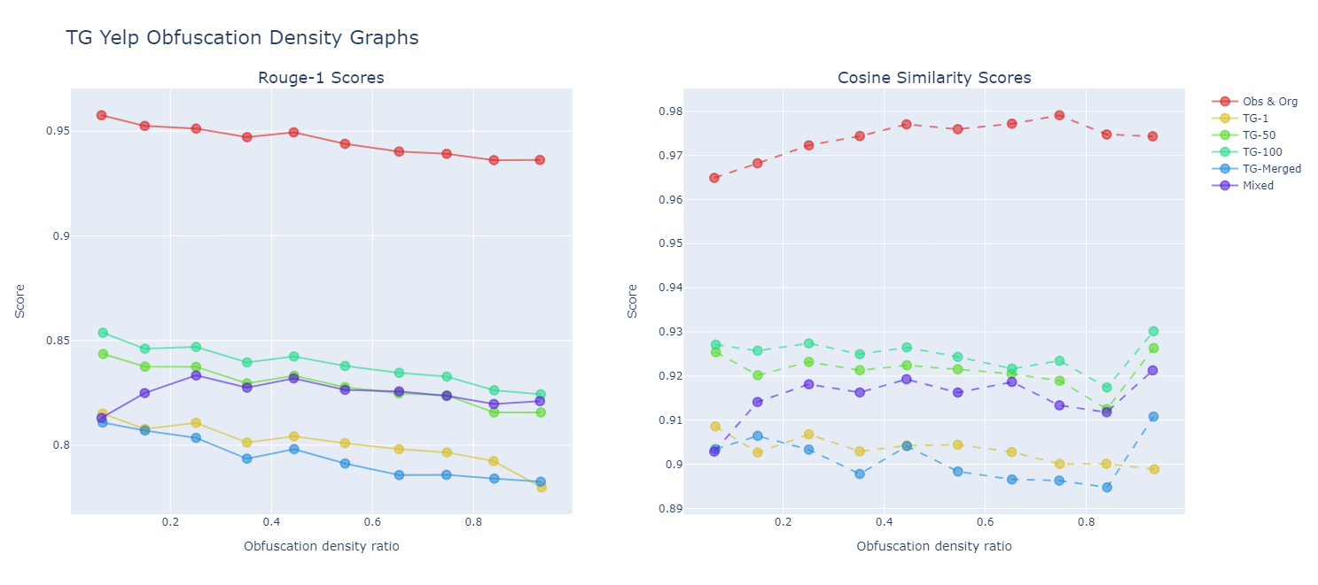
Main Finding 4: The Importance Lies in Obfuscation Percentage, Not Location
Scores curves are parallel thorughtout the obfuscation density
&
Obs & Org curve is at top
Keynote:
In ratio:
0 is the beginning of the sentence.
1 is the end of the sentence.

Slide 33
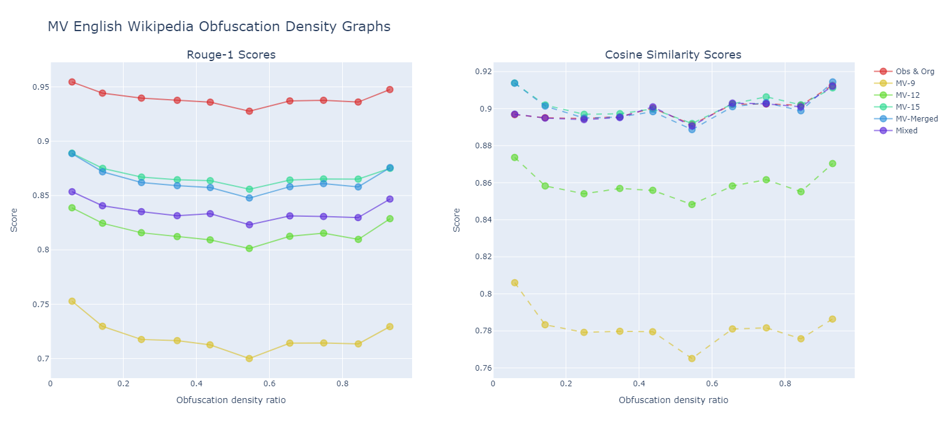
Main Finding 4: The Importance Lies in Obfuscation Percentage, Not Location
Scores curves are parallel thorughtout the obfuscation density
&
Obs & Org curve is at top
Keynote:
In ratio:
0 is the beginning of the sentence.
1 is the end of the sentence.

Slide 34
Main Findings
1
4
Familiarity with the DP Mechanism is Advantages for Attackers
3
Epsilon Knowledge is Negligible for Adversaries
The Importance Lies in Obfuscation Percentage, Not Location
2
The Significance of Training Dataset Similarity to the Test Set
5
Absence of Error Accumulation in Text Generation Models

Slide 35
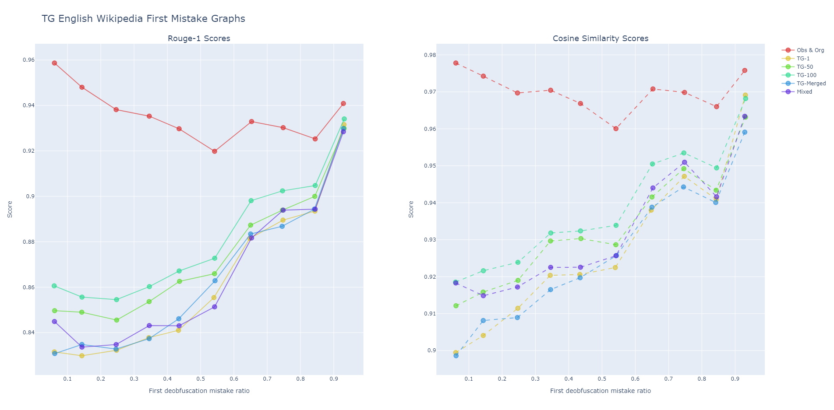
Main Finding 5: Absence of Error Accumulation in Text Generation Models
The score curve is roughly linear = models are not more prone to errors after an initial incorrectly predicted word earlier in the sentence.
Keynote:
In ratio:
0 is the beginning of the sentence.
1 is the end of the sentence.

Slide 36
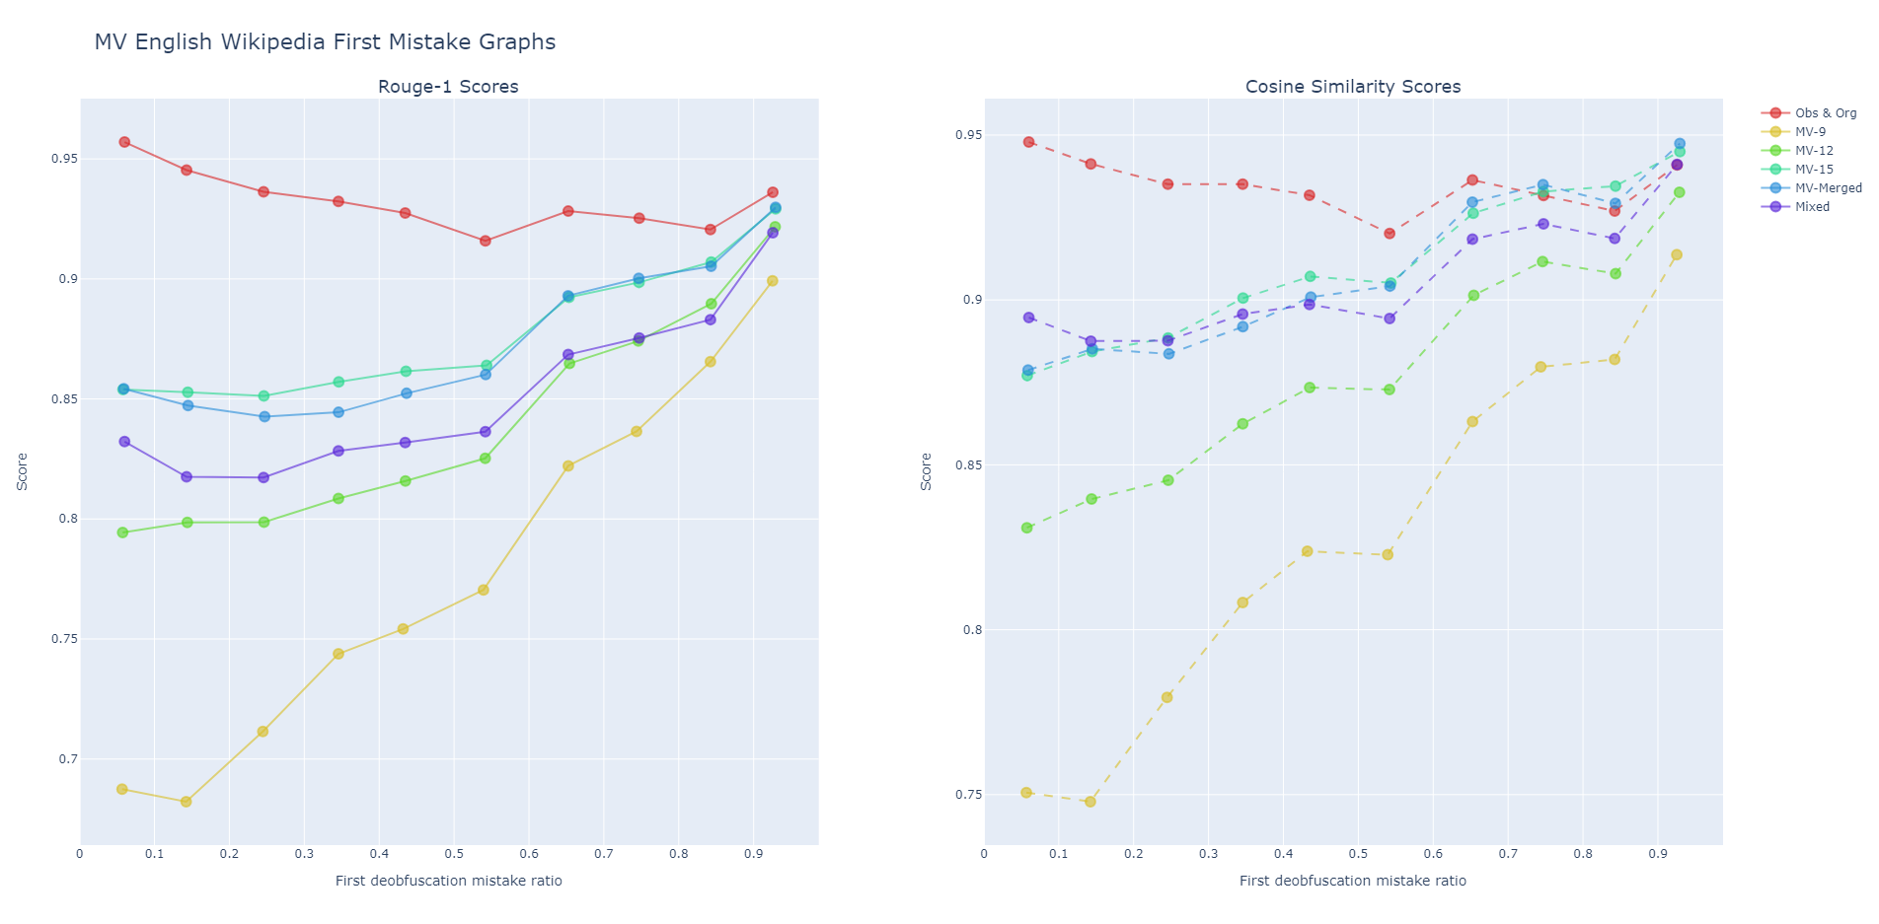
Main Finding 5: Absence of Error Accumulation in Text Generation Models
The score curve is roughly linear = models are not more prone to errors after an initial incorrectly predicted word earlier in the sentence.
Keynote:
In ratio:
0 is the beginning of the sentence.
1 is the end of the sentence.

Slide 37
Research Questions
What prerequisites must be satisfied in order for an attacker to infer original plaintext from privatized, obfuscated text outputs?
Train & test set similarity is important
Knowing DP mechanism is beneficial
What specific training methodologies and architectural features are essential for a model to possess the capability to be able to retrieve the original plaintext?
Text generation models are suitable. No error accumulation occurs
What are the suitable metrics to assess how well these models work in terms of recovering the original plaintext?
The ROUGE score is good for word overlap
The cosine similarity score is good for semantic similarity
How can a benchmark be devised to evaluate and compare the resilience of alternative models trained with word-level differential privacy for privatizing textual inputs against an attacker's attempts to infer the original inputs?
General test: classical test on a dataset
Knowing 𝜺 is negligible
Epsilon test: learn DP mechanisms behavior with respect to 𝜺
Word deobfuscation test: Learn whether your adversarial model architecture has a weakness

Slide 38
Outline
Motivation
Research Questions
Methodology
Results & Main Findings
Limitations & Future Work

Slide 39
Limitations & Future Work
Limitations
Use of only 2 DP mechanisms
Computational constraints, therefore only T5 small model is used
Analysis restricted to Wikipedia and Yelp datasets, without examining sensitive or specific information
Future Work
Additional DP mechanisms can be explored.
More advanced adversatial models can be evaluated.
Testing can focus on datasets containing sensitive information.
Word-level tokenizers and consistent embeddings with DP mechanisms can be tested in adversarial models.

Slide 40
Furkan Yılmaz
furkan.yilmaz@tum.de

Slide 41
Main Finding 1: Knowing DP Mechanism is Important
English Wikipedia
Yelp
Truncated-Gumbel Test Set Results
Model Trained on | Rouge 1 | Rouge 2 | Rouge L | Rouge Lsum | Cosine Similarity | Cross Entropy
TG 𝜺=1 | 0.703 / 0.398 | 0.509 / 0.145 | 0.698 / 0.383 | 0.698 / 0.383 | 0.825 / 0.742 | 0.909
TG 𝜺=50 | 0.705 / 0.398 | 0.511 / 0.145 | 0.700 / 0.383 | 0.700 / 0.383 | 0.827 / 0.742 | 0.919
TG 𝜺=100 | 0.703 / 0.398 | 0.509 / 0.145 | 0.698 / 0.383 | 0.698 / 0.383 | 0.827 / 0.742 | 0.933
TG all 𝜺’s | 0.724 / 0.398 | 0.541 / 0.145 | 0.720 / 0.383 | 0.719 / 0.383 | 0.840 / 0.742 | 0.991
TG all 𝜺’s MV all 𝜺’s | 0.714 / 0.398 | 0.530 / 0.145 | 0.709 / 0.383 | 0.709 / 0.383 | 0.829 / 0.742 | 0.853
MV all 𝜺’s | 0.558 / 0.398 | 0.326 / 0.145 | 0.542 / 0.383 | 0.542 / 0.383 | 0.744 / 0.742 | 1.542
TG 𝜺=1 | 0.575 / 0.36 | 0.338 / 0.104 | 0.555 / 0.328 | 0.555 / 0.328 | 0.766 / 0.728 | 1.53
TG 𝜺=50 | 0.584 / 0.36 | 0.346 / 0.104 | 0.565 / 0.328 | 0.565 / 0.328 | 0.775 / 0.728 | 1.52
TG 𝜺=100 | 0.585 / 0.36 | 0.346 / 0.104 | 0.566 / 0.328 | 0.565 / 0.328 | 0.775 / 0.728 | 1.53
TG all 𝜺’s | 0.584 / 0.36 | 0.347 / 0.104 | 0.565 / 0.328 | 0.565 / 0.328 | 0.769 / 0.728 | 1.615
TG all 𝜺’s MV all 𝜺’s | 0.536 / 0.36 | 0.29 / 0.104 | 0.512 / 0.328 | 0.512 / 0.328 | 0.746 / 0.728 | 1.803
MV all 𝜺’s | 0.427 / 0.36 | 0.166 / 0.104 | 0.381 / 0.328 | 0.381 / 0.328 | 0.651 / 0.728 | 2.546

Slide 42
Main Finding 1: Knowing DP Mechanism is Important
English Wikipedia
Yelp
Multivariate-Calibrate Test Set Results
Model Trained on | Rouge 1 | Rouge 2 | Rouge L | Rouge Lsum | Cosine Similarity | Cross Entropy
MV 𝜺=9 | 0.348 / 0.23 | 0.132 / 0.068 | 0.32 / 0.229 | 0.32 / 0.229 | 0.47 / 0.386 | 2.508
MV 𝜺=12 | 0.364 / 0.23 | 0.141 / 0.068 | 0.335 / 0.229 | 0.335 / 0.229 | 0.487 / 0.386 | 2.487
MV 𝜺=15 | 0.374 / 0.23 | 0.148 / 0.068 | 0.346 / 0.229 | 0.346 / 0.229 | 0.495 / 0.386 | 2.551
MV all 𝜺’s | 0.386 / 0.23 | 0.164 / 0.068 | 0.357 / 0.229 | 0.357 / 0.229 | 0.515 / 0.386 | 2.469
TG all 𝜺’s MV all 𝜺’s | 0.367 / 0.23 | 0.149 / 0.068 | 0.338 / 0.229 | 0.338 / 0.229 | 0.494 / 0.386 | 2.32
TG all 𝜺’s | 0.21 / 0.23 | 0.063 / 0.068 | 0.206 / 0.229 | 0.206 / 0.229 | 0.375 / 0.386 | 6.053
MV 𝜺=9 | 0.249 / 0.295 | 0.059 / 0.114 | 0.208 / 0.292 | 0.208 / 0.292 | 0.321 / 0.458 | 3.652
MV 𝜺=12 | 0.304 / 0.295 | 0.096 / 0.114 | 0.258 / 0.292 | 0.258 / 0.292 | 0.402 / 0.458 | 3.338
MV 𝜺=15 | 0.352 / 0.295 | 0.124 / 0.114 | 0.303 / 0.292 | 0.303 / 0.292 | 0.462 / 0.458 | 3.338
MV all 𝜺’s | 0.336 / 0.295 | 0.116 / 0.114 | 0.289 / 0.292 | 0.289 / 0.292 | 0.432 / 0.458 | 3.533
TG all 𝜺’s MV all 𝜺’s | 0.283 / 0.295 | 0.091 / 0.114 | 0.243 / 0.292 | 0.243 / 0.292 | 0.386 / 0.458 | 3.534
TG all 𝜺’s | 0.242 / 0.295 | 0.079 / 0.114 | 0.231 / 0.292 | 0.231 / 0.292 | 0.427 / 0.458 | 6.558

Slide 43
Main Finding 2: The Significance of Training & Test Set Similarity
English Wikipedia
Yelp
Truncated-Gumbel Test Set Results
Model Trained on | Rouge 1 | Rouge 2 | Rouge L | Rouge Lsum | Cosine Similarity | Cross Entropy
TG 𝜺=1 | 0.703 / 0.398 | 0.509 / 0.145 | 0.698 / 0.383 | 0.698 / 0.383 | 0.825 / 0.742 | 0.909
TG 𝜺=50 | 0.705 / 0.398 | 0.511 / 0.145 | 0.700 / 0.383 | 0.700 / 0.383 | 0.827 / 0.742 | 0.919
TG 𝜺=100 | 0.703 / 0.398 | 0.509 / 0.145 | 0.698 / 0.383 | 0.698 / 0.383 | 0.827 / 0.742 | 0.933
TG all 𝜺’s | 0.724 / 0.398 | 0.541 / 0.145 | 0.720 / 0.383 | 0.719 / 0.383 | 0.840 / 0.742 | 0.991
TG all 𝜺’s MV all 𝜺’s | 0.714 / 0.398 | 0.530 / 0.145 | 0.709 / 0.383 | 0.709 / 0.383 | 0.829 / 0.742 | 0.853
MV all 𝜺’s | 0.558 / 0.398 | 0.326 / 0.145 | 0.542 / 0.383 | 0.542 / 0.383 | 0.744 / 0.742 | 1.542
TG 𝜺=1 | 0.575 / 0.36 | 0.338 / 0.104 | 0.555 / 0.328 | 0.555 / 0.328 | 0.766 / 0.728 | 1.53
TG 𝜺=50 | 0.584 / 0.36 | 0.346 / 0.104 | 0.565 / 0.328 | 0.565 / 0.328 | 0.775 / 0.728 | 1.52
TG 𝜺=100 | 0.585 / 0.36 | 0.346 / 0.104 | 0.566 / 0.328 | 0.565 / 0.328 | 0.775 / 0.728 | 1.53
TG all 𝜺’s | 0.584 / 0.36 | 0.347 / 0.104 | 0.565 / 0.328 | 0.565 / 0.328 | 0.769 / 0.728 | 1.615
TG all 𝜺’s MV all 𝜺’s | 0.536 / 0.36 | 0.29 / 0.104 | 0.512 / 0.328 | 0.512 / 0.328 | 0.746 / 0.728 | 1.803
MV all 𝜺’s | 0.427 / 0.36 | 0.166 / 0.104 | 0.381 / 0.328 | 0.381 / 0.328 | 0.651 / 0.728 | 2.546

Slide 44
Main Finding 2: The Significance of Training & Test Set Similarity
English Wikipedia
Yelp
Multivariate-Calibrate Test Set Results
Model Trained on | Rouge 1 | Rouge 2 | Rouge L | Rouge Lsum | Cosine Similarity | Cross Entropy
MV 𝜺=9 | 0.348 / 0.23 | 0.132 / 0.068 | 0.32 / 0.229 | 0.32 / 0.229 | 0.47 / 0.386 | 2.508
MV 𝜺=12 | 0.364 / 0.23 | 0.141 / 0.068 | 0.335 / 0.229 | 0.335 / 0.229 | 0.487 / 0.386 | 2.487
MV 𝜺=15 | 0.374 / 0.23 | 0.148 / 0.068 | 0.346 / 0.229 | 0.346 / 0.229 | 0.495 / 0.386 | 2.551
MV all 𝜺’s | 0.386 / 0.23 | 0.164 / 0.068 | 0.357 / 0.229 | 0.357 / 0.229 | 0.515 / 0.386 | 2.469
TG all 𝜺’s MV all 𝜺’s | 0.367 / 0.23 | 0.149 / 0.068 | 0.338 / 0.229 | 0.338 / 0.229 | 0.494 / 0.386 | 2.32
TG all 𝜺’s | 0.21 / 0.23 | 0.063 / 0.068 | 0.206 / 0.229 | 0.206 / 0.229 | 0.375 / 0.386 | 6.053
MV 𝜺=9 | 0.249 / 0.295 | 0.059 / 0.114 | 0.208 / 0.292 | 0.208 / 0.292 | 0.321 / 0.458 | 3.652
MV 𝜺=12 | 0.304 / 0.295 | 0.096 / 0.114 | 0.258 / 0.292 | 0.258 / 0.292 | 0.402 / 0.458 | 3.338
MV 𝜺=15 | 0.352 / 0.295 | 0.124 / 0.114 | 0.303 / 0.292 | 0.303 / 0.292 | 0.462 / 0.458 | 3.338
MV all 𝜺’s | 0.336 / 0.295 | 0.116 / 0.114 | 0.289 / 0.292 | 0.289 / 0.292 | 0.432 / 0.458 | 3.533
TG all 𝜺’s MV all 𝜺’s | 0.283 / 0.295 | 0.091 / 0.114 | 0.243 / 0.292 | 0.243 / 0.292 | 0.386 / 0.458 | 3.534
TG all 𝜺’s | 0.242 / 0.295 | 0.079 / 0.114 | 0.231 / 0.292 | 0.231 / 0.292 | 0.427 / 0.458 | 6.558

Slide 45
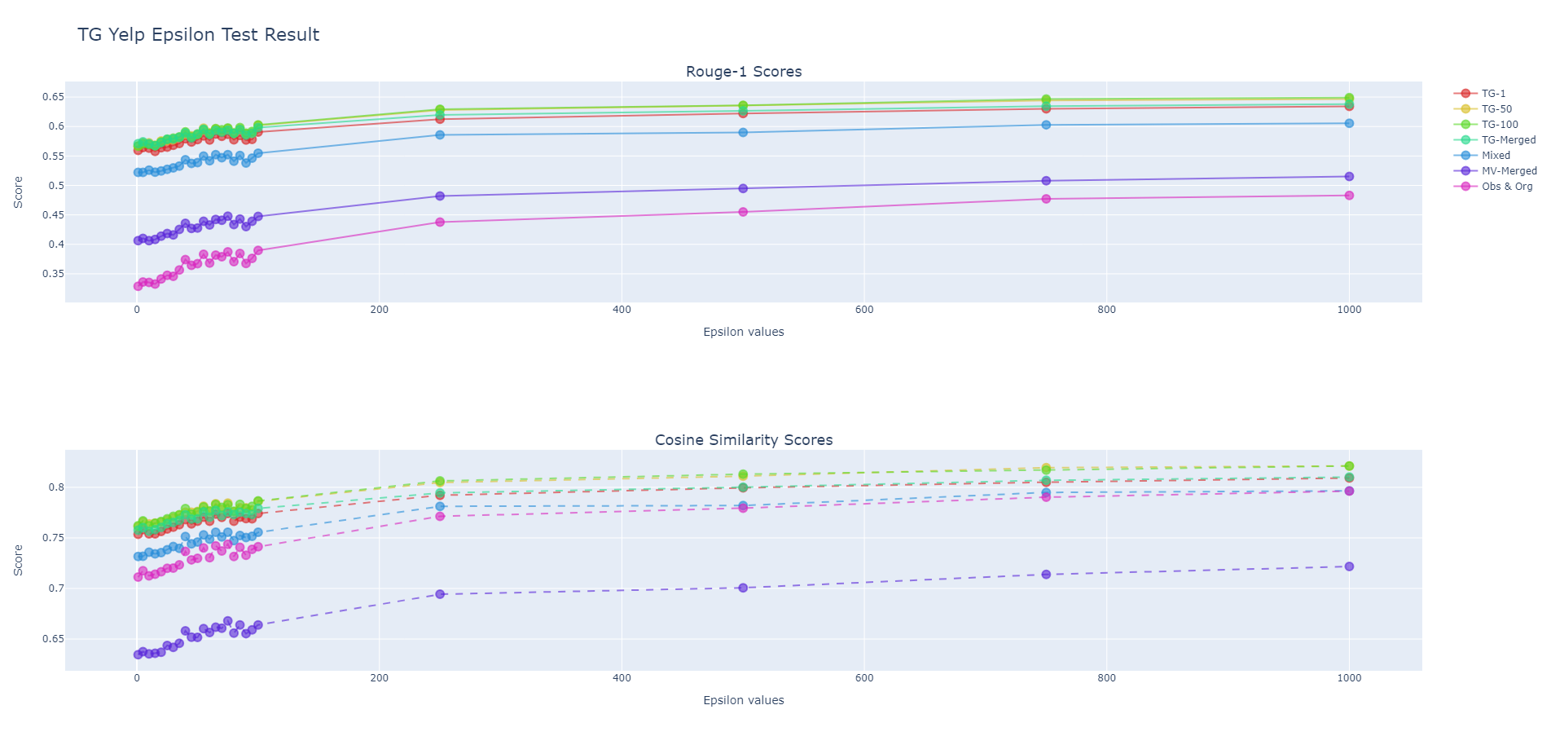
Main Finding 3: Epsilon Knowledge is Negligible for Adversaries
Models trained with
all 𝜺 values & highest 𝜺 value
stays at the top in general
Models trained with
all 𝜺 values & highest 𝜺 value
stays at the top in general

Slide 46
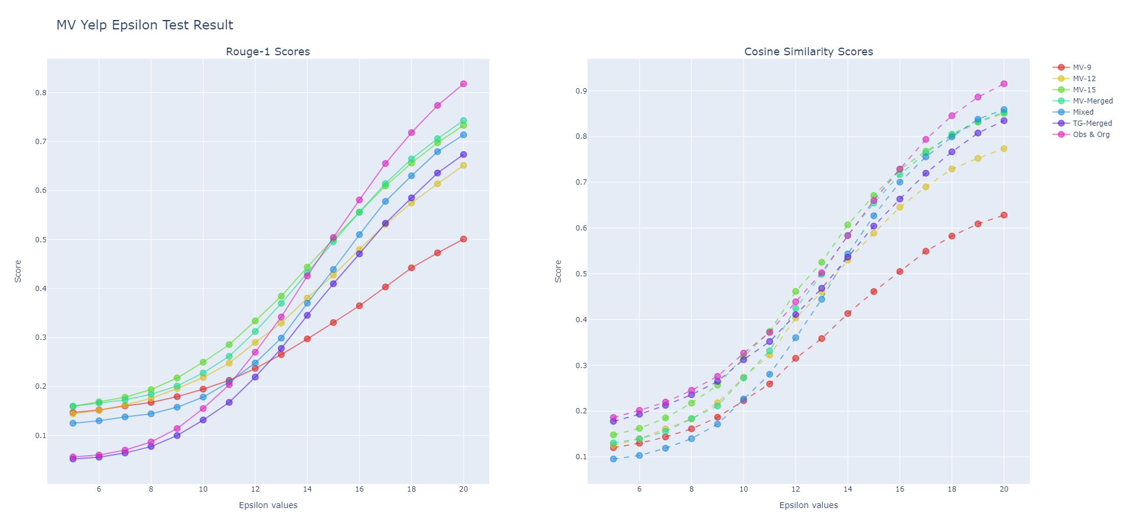
Main Finding 3: Epsilon Knowledge is Negligible for Adversaries
Models trained with
all 𝜺 values & highest 𝜺 value
stays at the top in general
Models trained with
all 𝜺 values & highest 𝜺 value
stays at the top in general

Slide 47
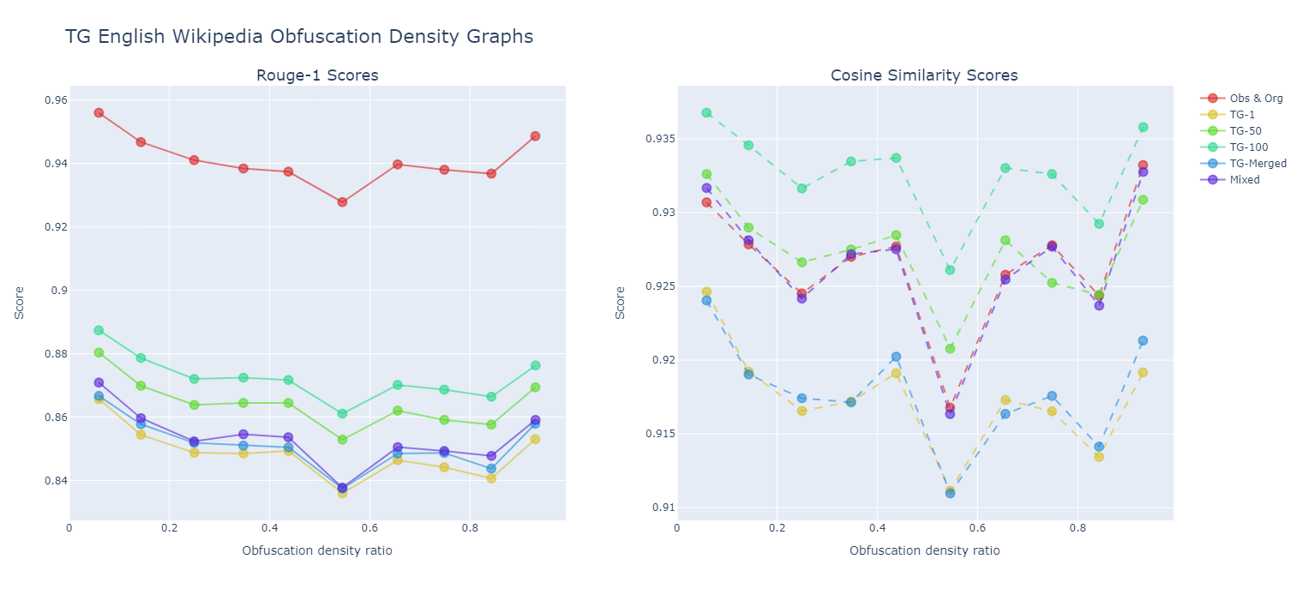
Main Finding 4: The Importance Lies in Obfuscation Percentage, Not Location
Scores curves are parallel thorughtout the obfuscation density
&
Obs & Org curve is at top

Slide 48
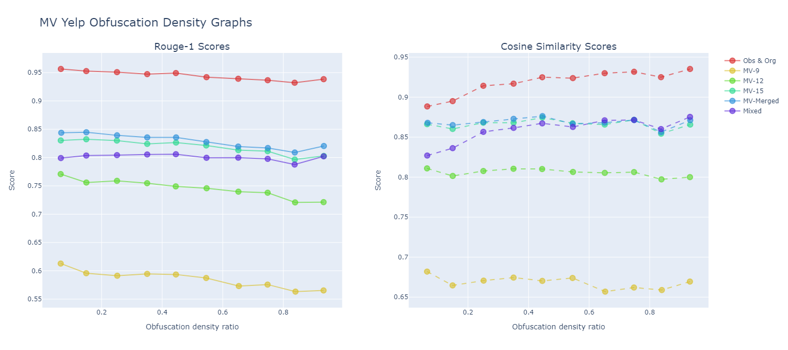
Main Finding 4: The Importance Lies in Obfuscation Percentage, Not Location
Scores curves are parallel thorughtout the obfuscation density
&
Obs & Org curve is at top

Slide 49
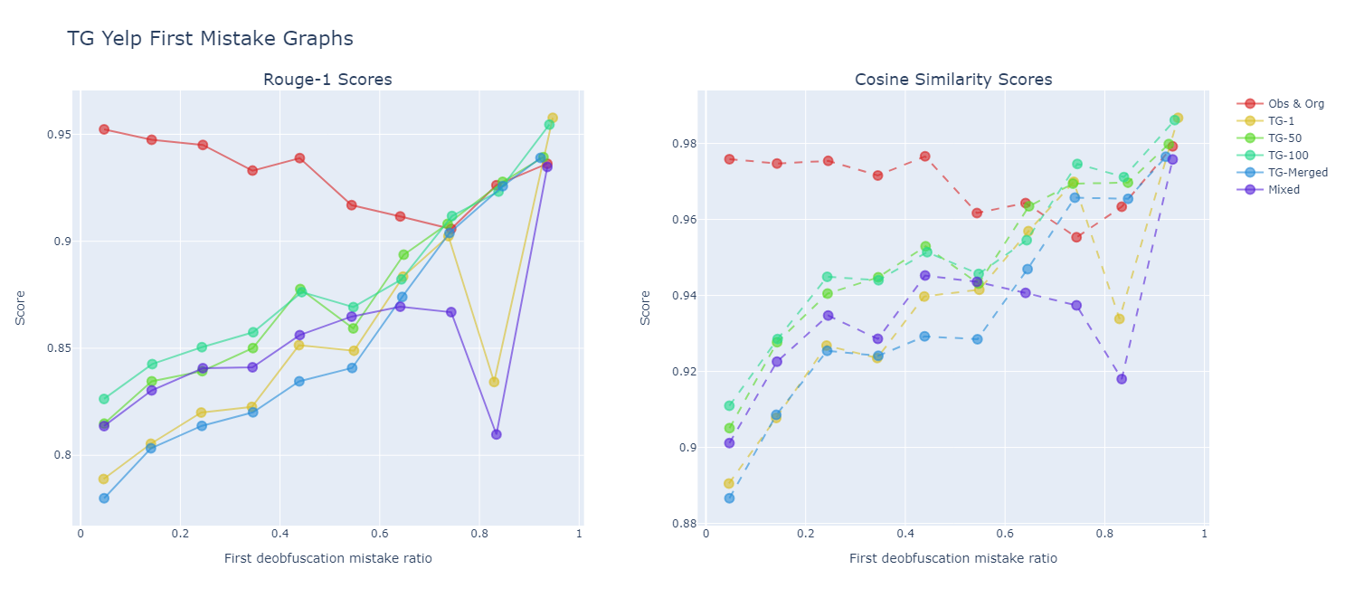
Main Finding 5: Absence of Error Accumulation in Text Generation Models
The score curve is roughly linear ! = Errors does not accumulate

Slide 50
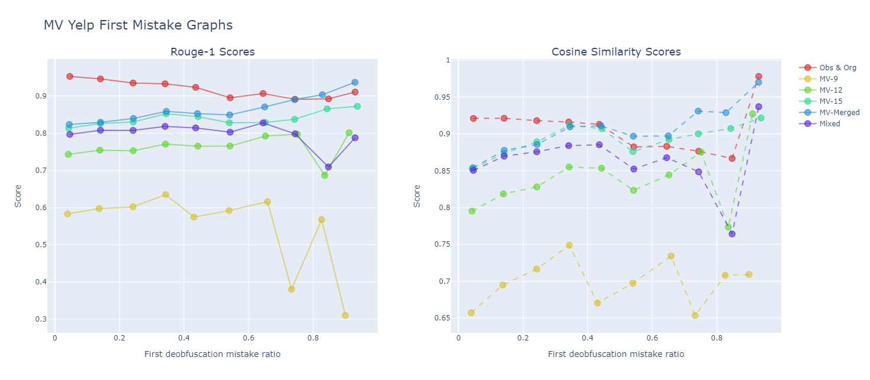
Main Finding 5: Absence of Error Accumulation in Text Generation Models
The score curve is roughly linear ! = Errors does not accumulate

Slide 51

Methodology – Model Train Phase
Shadow
Corpus
Truncated-Gumbel & Multivariate-Calibrate word–level DP mechanism are chosen and 6 datasets are with this mechanism is created.
Input
Output
Wikipedia
DP Mechanism
Obfuscated
Wikipedia
Shadow Corpus: A dataset that mirrors the characteristics of the main corpus
Dataset consists of original text and the obfuscated text.
Dataset (csv):
Original S.
Obfuscated S.
Original S.
Obfuscated S.
Original S.
Obfuscated S.
Original S.
Obfuscated S.
Differentially Private = Obfuscated
Wikipedia (Label)
Model
Obfuscated
Wikipedia
Different adversary NLP models will be trained
Loss()
Predict
Feed
Prediction
Update
weights

Slide 52


Methodology – Model Train Phase
Obfuscated Public Text
Private Text
A specific word–level mechanism will be chosen and dataset with this mechanism will be created.
Dataset consists of original text and the obfuscated text.
The metrics to be used for training the adversary NLP model will be determined.
Different adversary NLP models with hyperparameters will be tested with cross-validation.
Hyperparameter selections and finetuning will be done.
The best model will be chosen.
Generated Text
Obfuscated Text
Train Adversary Model
Inference Attack

Slide 53
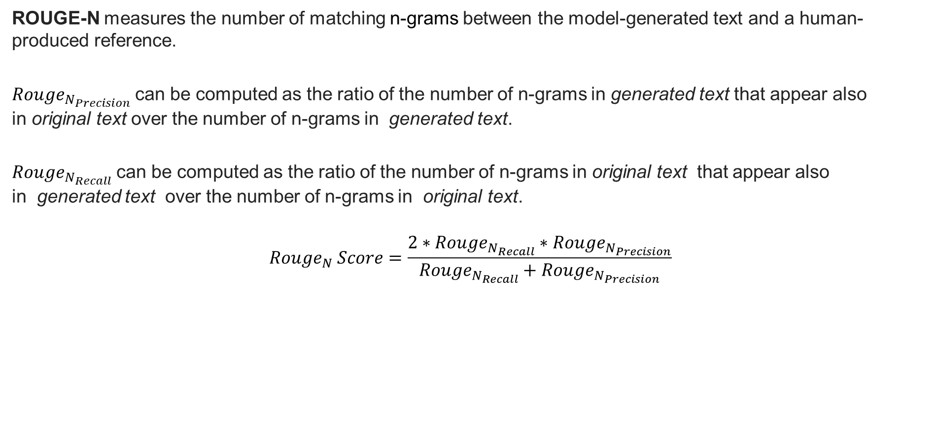
Rouge-N
ROUGE-N measures the number of matching n-grams between the model-generated text and a human-produced reference.
$Rouge_{N_{Precision}}$can be computed as the ratio of the number of n-grams in generated text that appear also in original text over the number of n-grams in generated text.
$Rouge_{N_{Recall}}$can be computed as the ratio of the number of n-grams in original text that appear also in generated text over the number of n-grams in original text.
$$Rouge_{N} Score=\frac{2∗Rouge_{N_{Recall}}∗Rouge_{N_{Precision}}}{Rouge_{N_{Recall}}+Rouge_{N_{Precision}}}$$

Slide 54
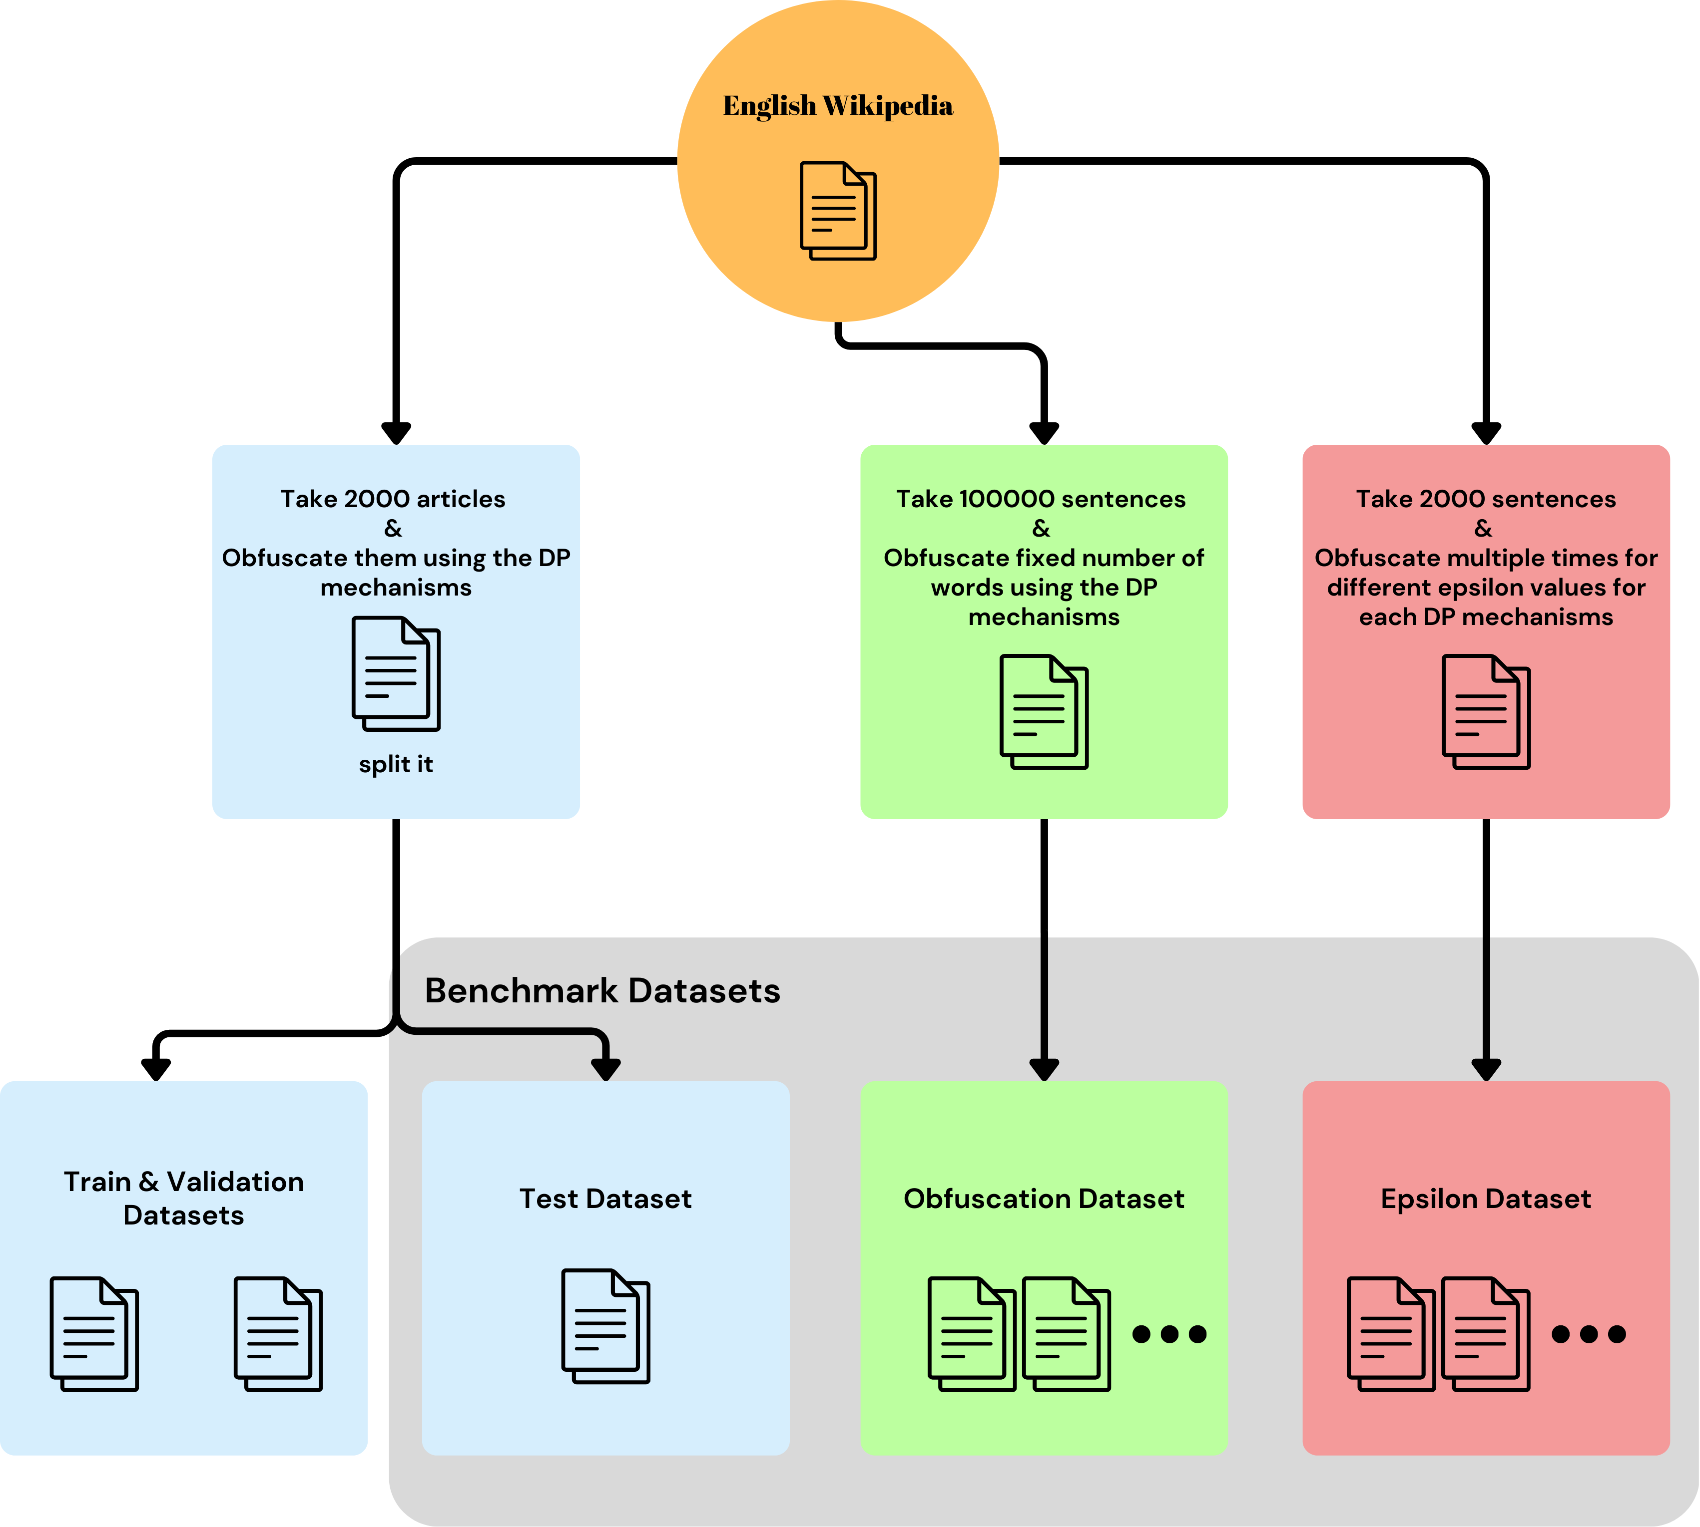

Slide 55
Stick to the good sebis traditions
  Provide action links at the bottom of the slide to guide the audience to our web pages or publications (see below). (Select the text, press CTRL-K)
  Use a file name according to our sebis conventions which helps us and our audience to find the file of your presentation on our web site with Google search:
    YYMMDD Author Short Title
    Include this string in the footer (Einfügen -> Kopf- und Fusszeile -> Fusszeile)
    The unusual date format simplifies the search for the latest version of a slide in an alphabetical directory listing (Dropbox, Explorer, Tricia, Sky-Drive)
[Ha13g] Hauder, M., Roth, S., Matthes, F.: Current Tool support for Metrics in Enterprise Architecture Management
For more information visit BEAMS , EAM Pattern Catalog and EAM KPI Catalog (http://wwwmatthes.in.tum.de)

Slide 56
Use the sebis visual language
(shapes, fonts, colors, sizes)
Default
Line Style
Default Rectangle
Default
Rounded R.
Text
Default
Text
User
Store
Information
Arrow
Cloud
Process
Box
Explanation
Fast
Form 1
Fast
Form 2
Fast
Form 3
Fast
Form 4
Fast
Form 5
Fast
Form 6
Fast
Form 6
Fast
Form 1
Fast
Form 2
Fast
Form 3
Fast
Form 4
Fast
Form 5
Fast
Form 6
Fast
Form 6

